Slide 1
Friction

Slide 2
Contents
Introduction
Laws of Dry Friction. Coefficients of Friction.
Angles of Friction
Problems Involving Dry Friction
Sample Problem 8.1
Sample Problem 8.3
Wedges
Square-Threaded Screws
Sample Problem 8.5
Journal Bearings. Axle Friction.
Thrust Bearings. Disk Friction.
Wheel Friction. Rolling Resistance.
Sample Problem 8.6
Belt Friction.
Sample Problem 8.8
8 - <number>

Slide 3
Introduction
In preceding topics, it was assumed that surfaces in contact were either frictionless (surfaces could move freely with respect to each other) or rough (tangential forces prevent relative motion between surfaces).
Actually, no perfectly frictionless surface exists. For two surfaces in contact, tangential forces, called friction forces, will develop if one attempts to move one relative to the other.
However, the friction forces are limited in magnitude and will not prevent motion if sufficiently large forces are applied.
The distinction between frictionless and rough is, therefore, a matter of degree.
There are two types of friction: dry or Coulomb friction and fluid friction. Fluid friction applies to lubricated mechanisms. The present discussion is limited to dry friction between nonlubricated surfaces.
8 - <number>

Slide 4
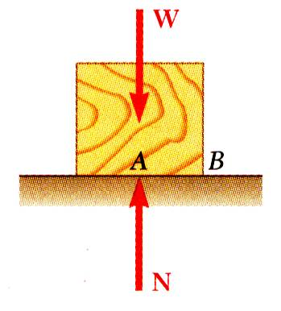
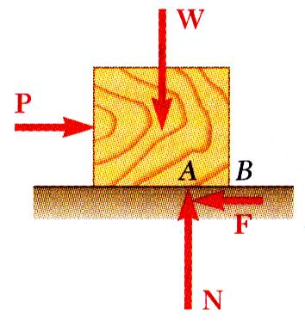
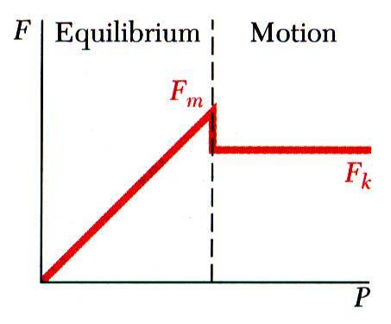


The Laws of Dry Friction. Coefficients of Friction
Block of weight W placed on horizontal surface. Forces acting on block are its weight and reaction of surface N.
Small horizontal force P applied to block. For block to remain stationary, in equilibrium, a horizontal component F of the surface reaction is required. F is a static-friction force.
As P increases, the static-friction force F increases as well until it reaches a maximum value F_{m}.
Further increase in P causes the block to begin to move as F drops to a smaller kinetic-friction force F_{k}.
8 - <number>

Slide 5
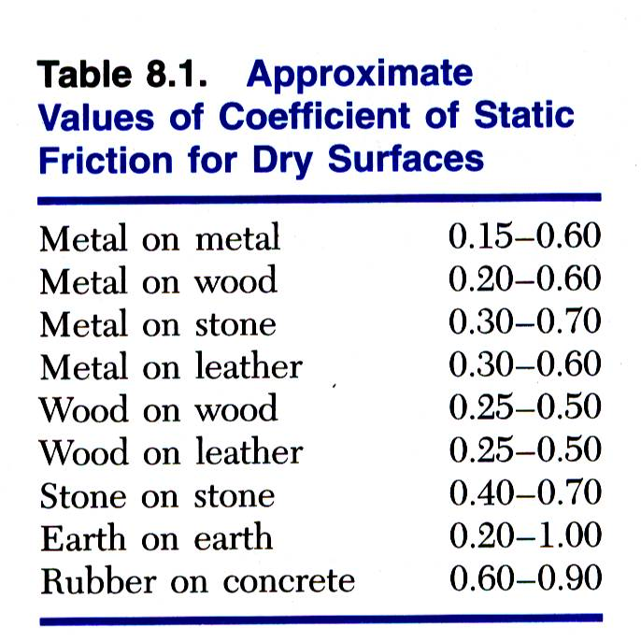
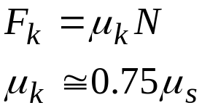
The Laws of Dry Friction. Coefficients of Friction
Maximum static-friction force:
Kinetic-friction force:
Maximum static-friction force and kinetic-friction force are:
  acts in the direction, opposite of which the body tend to move
  proportional to normal force
  dependent on type and condition of contact surfaces
  independent of contact area
8 - <number>

Slide 6
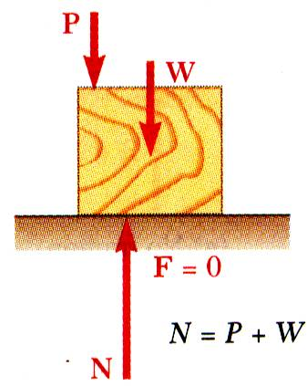
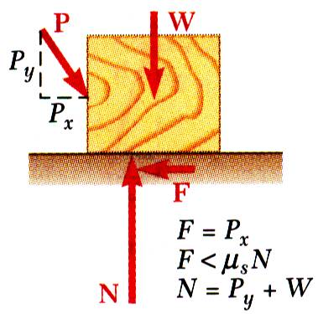
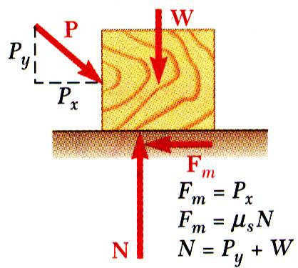
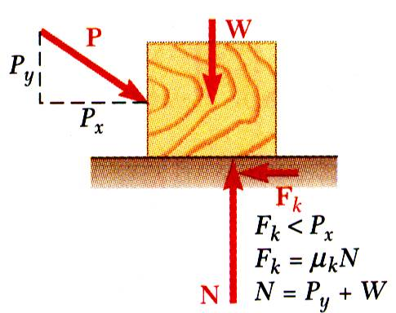
The Laws of Dry Friction. Coefficients of Friction
Four situations can occur when a rigid body is in contact with a horizontal surface:
No friction,
(P_{x} = 0)
No motion,
(P_{x} < F_{m})
Motion impending,
(P_{x} = F_{m})
Motion,
(P_{x} > F_{m})
8 - <number>

Slide 7
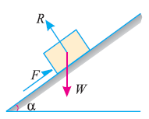
Angles of Friction
Consider a body of weight W resting on an inclined plane as shown in Figure.
We know that body is in equilibrium under the action of the following forces:
  Weight (W) of the body, acting vertically downwards
  Friction force (F) acting upwards along the plane
  Normal reaction (R) acting at right angle to plane
Let the angle of inclination (α) be gradually increased, till the body just starts to slide down the plane.
This angle of inclined plane, at which a body just begins to slide down the plane, is called the “Angle of Friction”.
8 - <number>

Slide 8
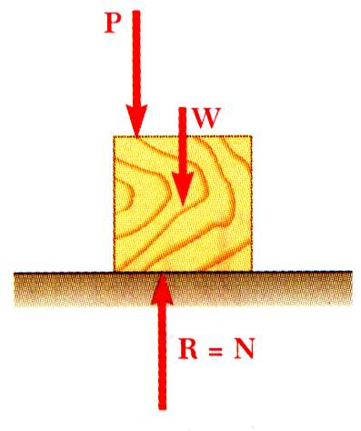
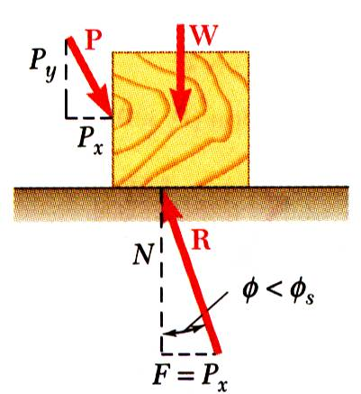
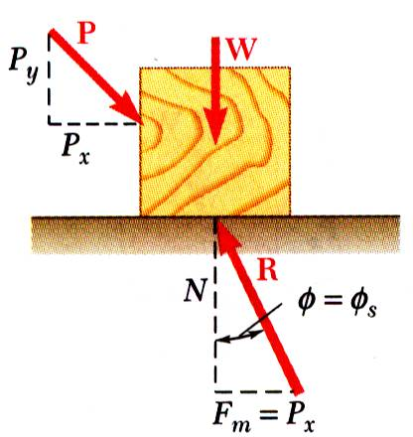
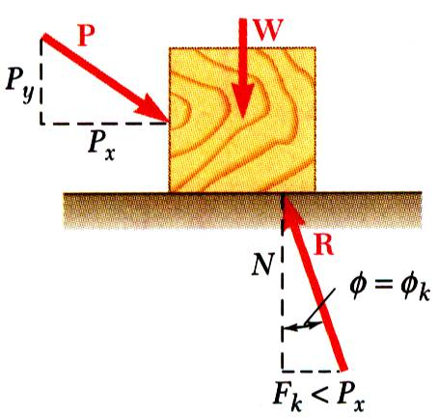
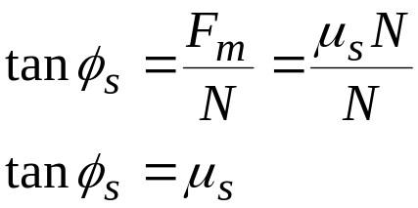
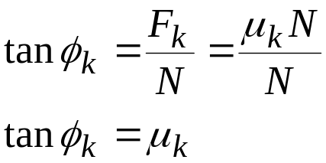
Angles of Friction
It is sometimes convenient to replace normal force N and friction force F by their resultant R:
No friction
No motion
Motion impending
Motion
8 - <number>

Slide 9
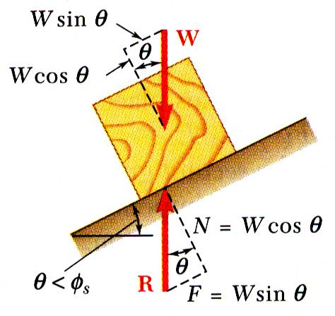
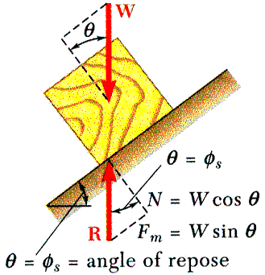
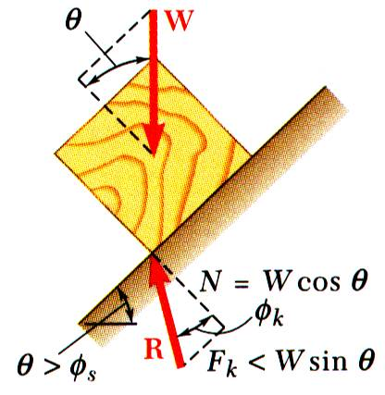
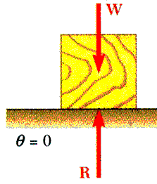
Angles of Friction
Consider block of weight W resting on board with variable inclination angle θ.
No friction
No motion
Motion impending
Motion
8 - <number>

Slide 10
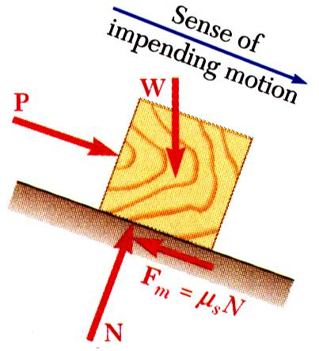
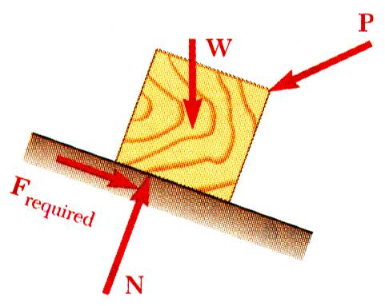
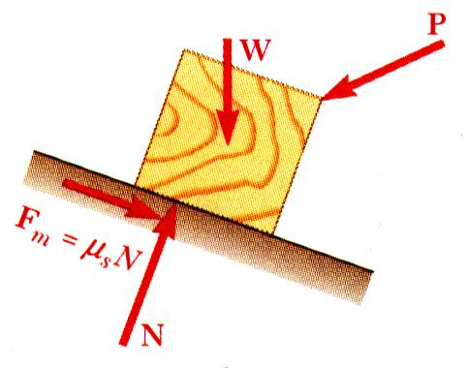
Problems Involving Dry Friction
All applied forces known
Coefficient of static friction is known
Determine whether body will remain at rest or slide
All applied forces known
Motion is impending
Determine value of coefficient of static friction.
Coefficient of static friction is known
Motion is impending
Determine magnitude or direction of one of the applied forces
8 - <number>

Slide 11
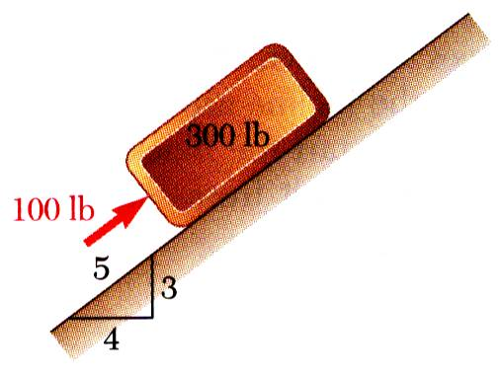
Sample Problem 8.1
SOLUTION:
Determine values of friction force and normal reaction force from plane required to maintain equilibrium.
Calculate maximum friction force and compare with friction force required for equilibrium. If it is greater, block will not slide.
If maximum friction force is less than friction force required for equilibrium, block will slide. Calculate kinetic-friction force.
A 100 lb force acts as shown on a 300 lb block placed on an inclined plane. The coefficients of friction between the block and plane are μ_{s} = 0.25 and μ_{k} = 0.20. Determine whether the block is in equilibrium and find the value of the friction force.
8 - <number>

Slide 12
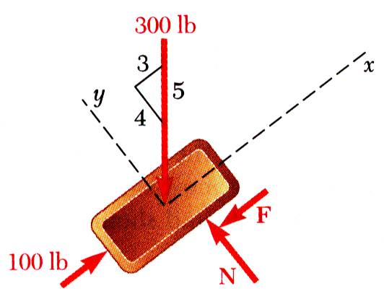






Sample Problem 8.1
SOLUTION:
Determine values of friction force and normal reaction force from plane required to maintain equilibrium.
Calculate maximum friction force and compare with friction force required for equilibrium. If it is greater, block will not slide.
The block will slide up the plane.
8 - <number>

Slide 13
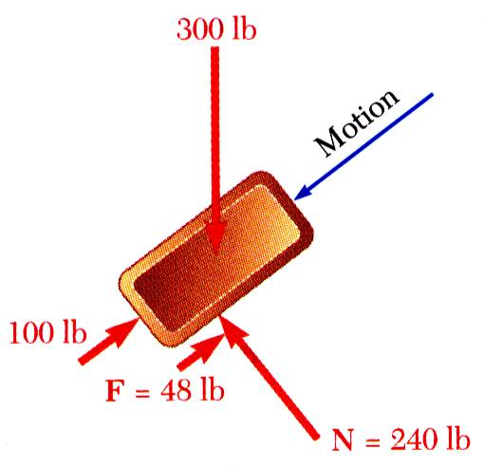
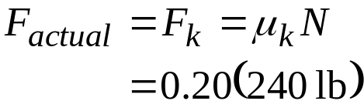

Sample Problem 8.1
If maximum friction force is less than friction force required for equilibrium, block will slide. Calculate kinetic-friction force.
8 - <number>

Slide 14
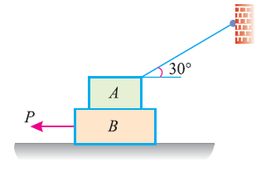
Sample Problem 8.2
Two blocks A and B of weights 1 kN and 2 kN respectively are in equilibrium position as shown in Figure.
If the coefficient of friction between the two blocks as well as the block B and the floor is 0.3, find the force (P) required to move the block B.
8 - <number>

Slide 15
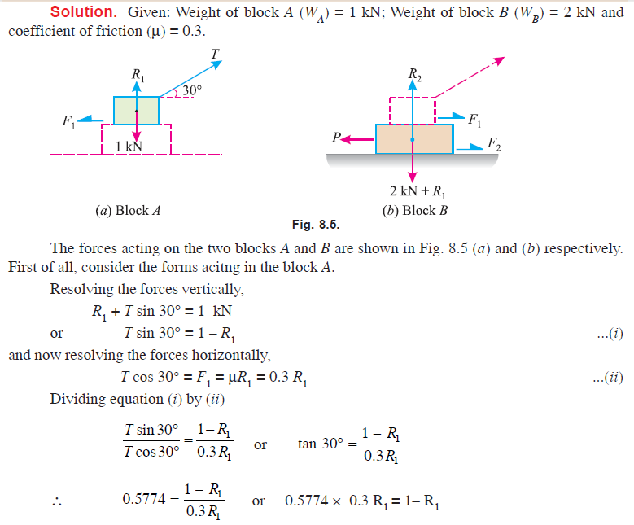
Sample Problem 8.2: Solution
8 - <number>

Slide 16
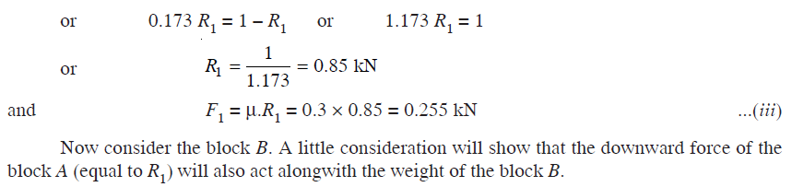
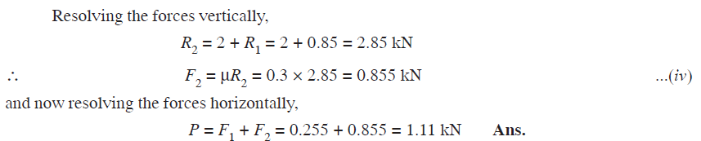
Sample Problem 8.2: Solution cont…
8 - <number>

Slide 17
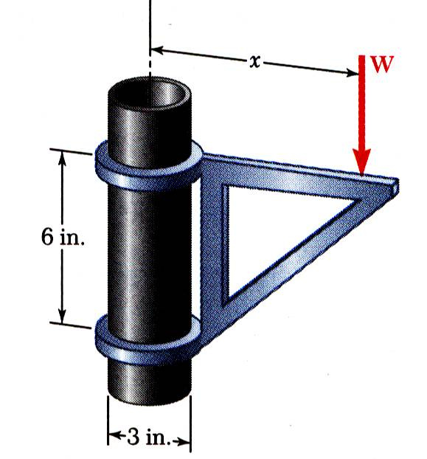
Sample Problem 8.3
SOLUTION:
When W is placed at minimum x, the bracket is about to slip and friction forces in upper and lower collars are at maximum value.
Apply conditions for static equilibrium to find minimum x.
The moveable bracket shown may be placed at any height on the 3-in. diameter pipe. If the coefficient of friction between the pipe and bracket is 0.25, determine the minimum distance x at which the load can be supported. Neglect the weight of the bracket.
8 - <number>

Slide 18
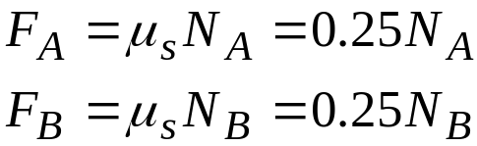


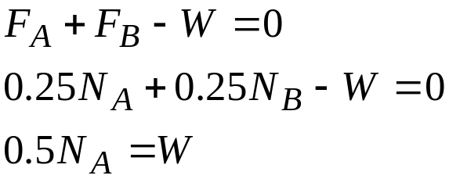
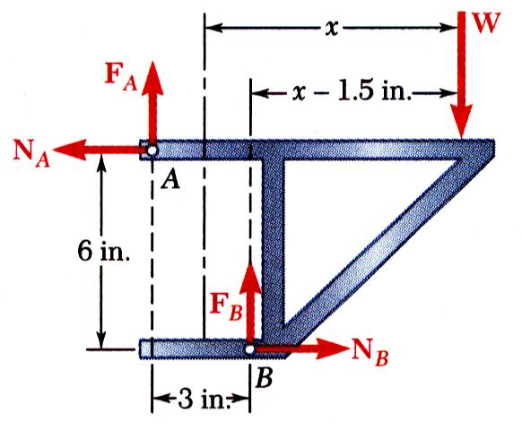


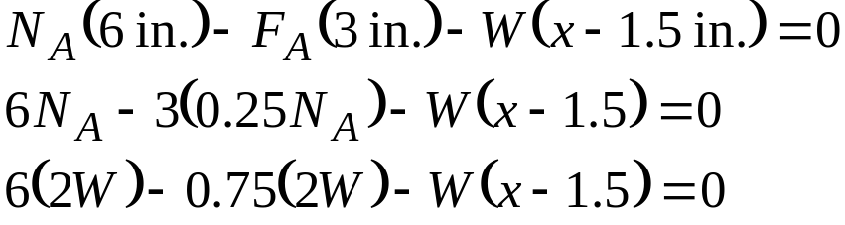

Sample Problem 8.3
SOLUTION:
When W is placed at minimum x, the bracket is about to slip and friction forces in upper and lower collars are at maximum value.
Apply conditions for static equilibrium to find minimum x.
8 - <number>

Slide 19
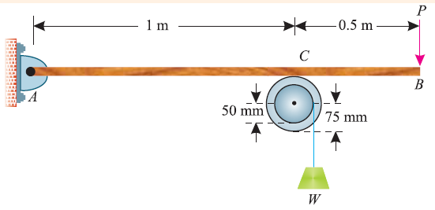
Sample Problem 8.4
What is the maximum load (W) which a force P equal to 5 kN will hold up, if the coefficient of friction at C is 0.2 in the arrangement shown in following Figure.
Neglect other friction and weight of the member:
If W = 3 kN and P = 4.5 kN, what are the normal and tangential forces transmitted at C?
8 - <number>

Slide 20
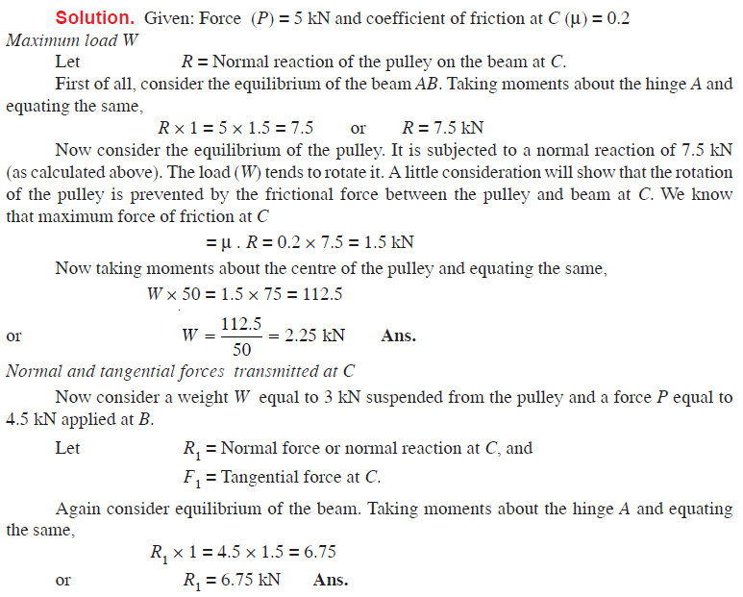
Sample Problem 8.4: Solution
8 - <number>

Slide 21
Sample Problem 8.4: Solution cont…
We know that the tangential force at C will be the frictional force between the pulley and beam. By applying,
F = µ N
Assumption : Coefficient of kinetic friction is equal to 0.2
F₁ = 0.2 x 6.75 = 1.35 kN Ans.
8 - <number>

Slide 22
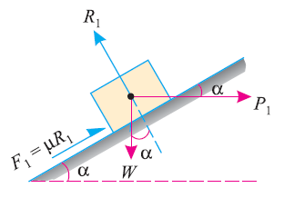
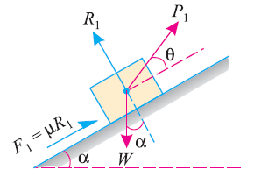
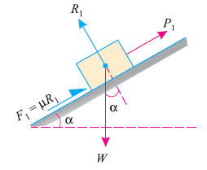
Equilibrium of a body on a rough inclined plane
Though there are many types of forces, for the movement of the body, yet the following are important from the subject point of view:
Force acting along the inclined plane
Force acting horizontally
Force acting at some angle with the inclined plane
8 - <number>

Slide 23
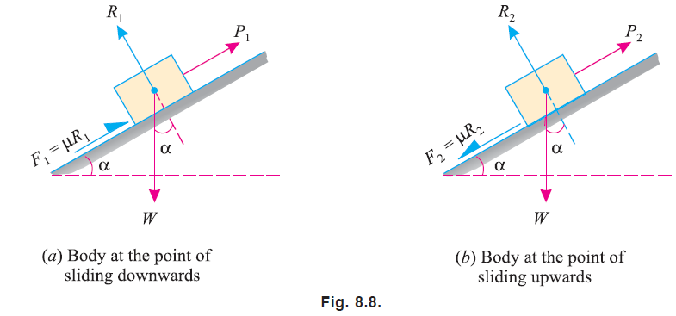
Equilibrium of a body on a rough inclined plane
Force acting along the inclined plane
Two cases as shown in Figure (a) and (b)
8 - <number>

Slide 24
Equilibrium of a body on a rough inclined plane
Force acting along the inclined plane
Minimum force (P₁) which will keep the body in equilibrium, when it is at the point of sliding downwards.
W = Weight of the body
α = Angle, which the inclined plane makes with the horizontal
R = Normal reaction
µ = Coefficient of friction between the body and the inclined plane
φ = Angle of friction, such that µ=tan φ
8 - <number>

Slide 25
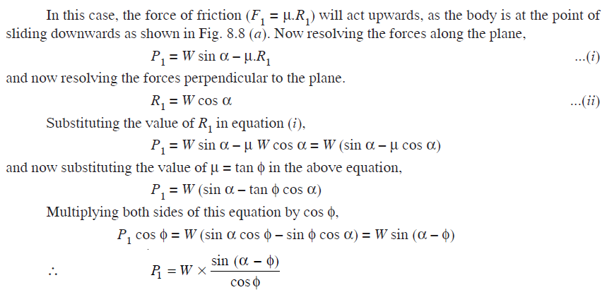
Equilibrium of a body on a rough inclined plane
Force acting along the inclined plane (cont…)
Minimum force (P₁) which will keep the body in equilibrium, when it is at the point of sliding downwards.
8 - <number>

Slide 26

Equilibrium of a body on a rough inclined plane
Force acting along the inclined plane
Maximum force (P₂) which will keep the body in equilibrium, when it is at the point of sliding upwards.
W = Weight of the body
α = Angle, which the inclined plane makes with the horizontal
R = Normal reaction
µ = Coefficient of friction between the body and the inclined plane
φ = Angle of friction, such that µ=tan φ
Similar to (1), it can be obtained;
8 - <number>

Slide 27
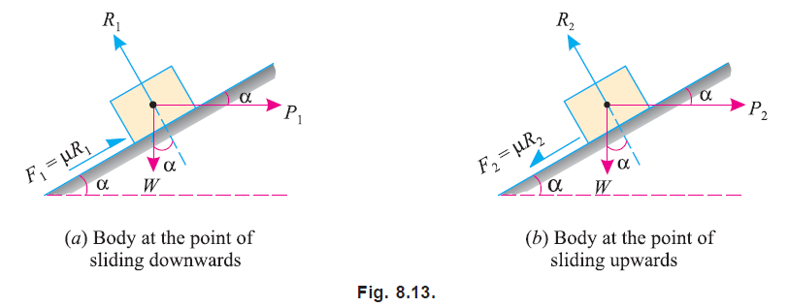
Equilibrium of a body on a rough inclined plane
Force acting horisontally
Two cases as shown in Figure (a) and (b)
P₁ = W tan (α - φ) …when (α > φ)
P₂ = W tan (α + φ)
8 - <number>

Slide 28
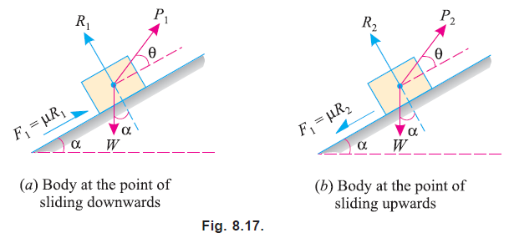


Equilibrium of a body on a rough inclined plane
Force acting at some angle with the inclined plane
Two cases as shown in Figure (a) and (b)
P₁
P₂
8 - <number>

Slide 29
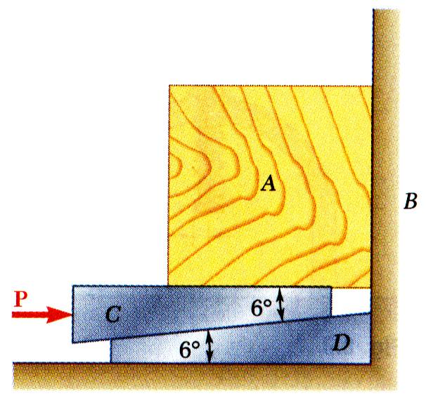
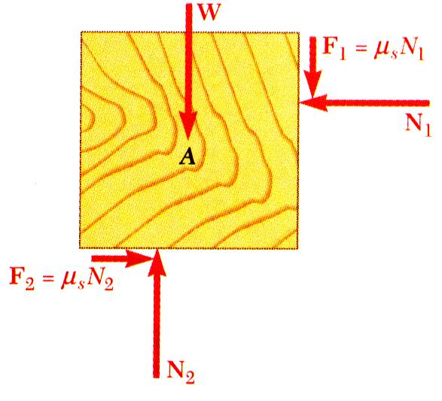
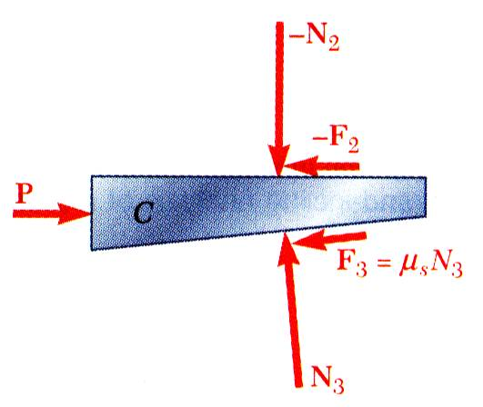
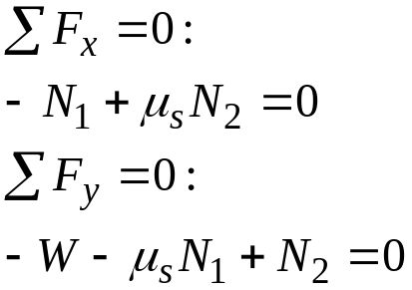
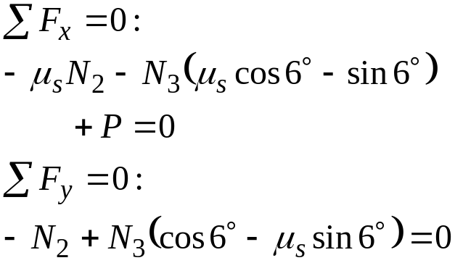


Wedges
Wedges - simple machines used to raise heavy loads.
Force required to lift block is significantly less than block weight.
Friction prevents wedge from sliding out.
Want to find minimum force P to raise block.
Block as free-body
Wedge as free-body
or
or
8 - <number>

Slide 30


Square-Threaded Screws
Square-threaded screws frequently used in jacks, presses, etc. Analysis similar to block on inclined plane. Recall, friction force does not depend on area of contact.
Thread of base has been “unwrapped” and shown as straight line. Slope is 2πr horizontally and lead L vertically.
8 - <number>

Slide 31






Square-Threaded Screws
Thread of base has been “unwrapped” and shown as straight line. Slope is 2πr horizontally and lead L vertically.
Moment of force Q is equal to moment of force P.
Impending motion upwards. Solve for Q.
Self-locking, solve for Q to lower load.
Non-locking, solve for Q to hold load.
8 - <number>

Slide 32

Sample Problem 8.5
SOLUTION
Calculate lead angle and pitch angle.
Using block and plane analogy with impending motion up the plane, calculate the clamping force with a force triangle.
A clamp is used to hold two pieces of wood together as shown. The clamp has a double square thread of mean diameter equal to 10 mm with a pitch of 2 mm. The coefficient of friction between threads is μ_{s} = 0.30.
If a maximum torque of 40 N*m is applied in tightening the clamp, determine (a) the force exerted on the pieces of wood, and (b) the torque required to loosen the clamp.
With impending motion down the plane, calculate the force and torque required to loosen the clamp.
8 - <number>

Slide 33








Sample Problem 8.5
SOLUTION
Calculate lead angle and pitch angle. For the double threaded screw, the lead L is equal to twice the pitch.
Using block and plane analogy with impending motion up the plane, calculate clamping force with force triangle.
8 - <number>

Slide 34






Sample Problem 8.5
With impending motion down the plane, calculate the force and torque required to loosen the clamp.
8 - <number>

Slide 35



Wheel Friction. Rolling Resistance
Point of wheel in contact with ground has no relative motion with respect to ground.
Ideally, no friction.
Moment M due to frictional resistance of axle bearing requires couple produced by equal and opposite P and F.
Without friction at rim, wheel would slide.
Deformations of wheel and ground cause resultant of ground reaction to be applied at B. P is required to balance moment of W about B.
Pr = Wb
b = coef of rolling resistance
8 - <number>

Slide 36



Sample Problem 8.6
SOLUTION:
With the load on the left and force P on the right, impending motion is clockwise to raise load. Sum moments about displaced contact point B to find P.
A pulley of diameter 4 in. can rotate about a fixed shaft of diameter 2 in. The coefficient of static friction between the pulley and shaft is 0.20.
Determine:
the smallest vertical force P required to start raising a 500 lb load,
the smallest vertical force P required to hold the load, and
the smallest horizontal force P required to start raising the same load.
Impending motion is counter-clockwise as load is held stationary with smallest force P. Sum moments about C to find P.
With the load on the left and force P acting horizontally to the right, impending motion is clockwise to raise load. Utilize a force triangle to find P.
8 - <number>

Slide 37


Sample Problem 8.6
SOLUTION:
With the load on the left and force P on the right, impending motion is clockwise to raise load. Sum moments about displaced contact point B to find P.
The perpendicular distance from center O of pulley to line of action of R is
Summing moments about B,
8 - <number>

Slide 38


Sample Problem 8.6
Impending motion is counter-clockwise as load is held stationary with smallest force P. Sum moments about C to find P.
The perpendicular distance from center O of pulley to line of action of R is again 0.20 in. Summing moments about C,
8 - <number>

Slide 39



Sample Problem 8.6
With the load on the left and force P acting horizontally to the right, impending motion is clockwise to raise load. Utilize a force triangle to find P.
Since W, P, and R are not parallel, they must be concurrent. Line of action of R must pass through intersection of W and P and be tangent to circle of friction which has radius r_{f} = 0.20 in.
From the force triangle,
8 - <number>

